Slide 1
Analyzing and Predicting
Airbnb Listing Price
Team 6
Presented by:
Aishwarya V
Ishan Gupta
Bhavika Patel
Sushmita Kalidasu
Srishti Jain
Mentor:Ankush Bansal

Slide 2
AGENDA:
Project Overview
About the dataset
Exploratory Data Analysis
Machine Learning Algorithms
Conclusion & Future Work

Slide 3
About AirBNB :
American Co. operates an online market place for vacation rentals and tourism activities.
Problem Statement:
Price is an important concern for customer booking online.
Solution:
Considering Basic Features from listings
eg: Price, , Property Types, Neighborhood will be Analyzed and algorithms will be used to give the best Accuracy for price.

Slide 4
Data Set
The data set comprises of 23K rows and 96 columns.
It consists of Airbnb properties present in Berlin location and
each listing comprises information about the property (e.g. property type, accommodates, location, number of accommodated guests, cancellation policy, lap - friendly etc) Also, we have columns related to host (e.g. whether the host is a super host, whether the identity of the host has been verified).
>> Our target - price

Slide 5
EDA ANALYSIS
We start by analysis on the dataset
First, errors in the dataset are considered and after their identification, they are fixed
And then target column is checked for the errors
Outliers in the target column are dealt with
Then, the null values are imputed
The co-linear relationship of the columns is analysed
Any other discrepancy in the data is dealt with

Slide 6
GEOSPATIAL ANALYSIS
LIBRARY USED- FOLIUM
The location of each and every Airbnb from the center and its price will be analyzed and plotted depending on different elements-
Neighborhood
Room type

Slide 7
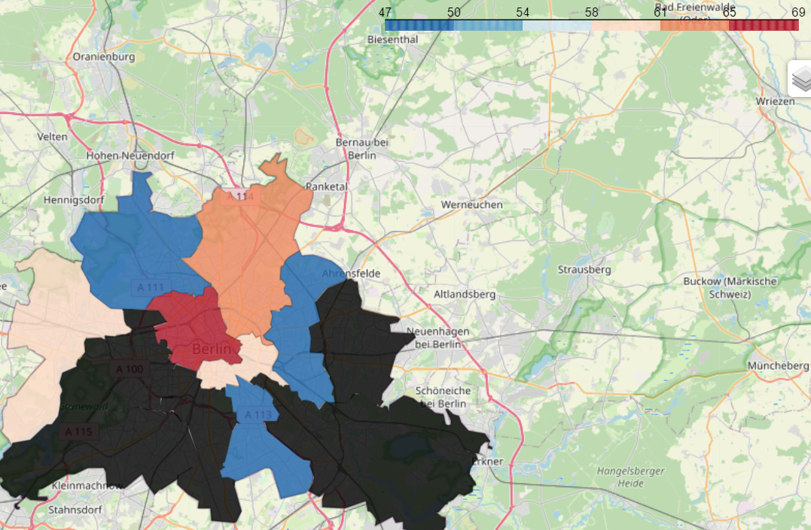
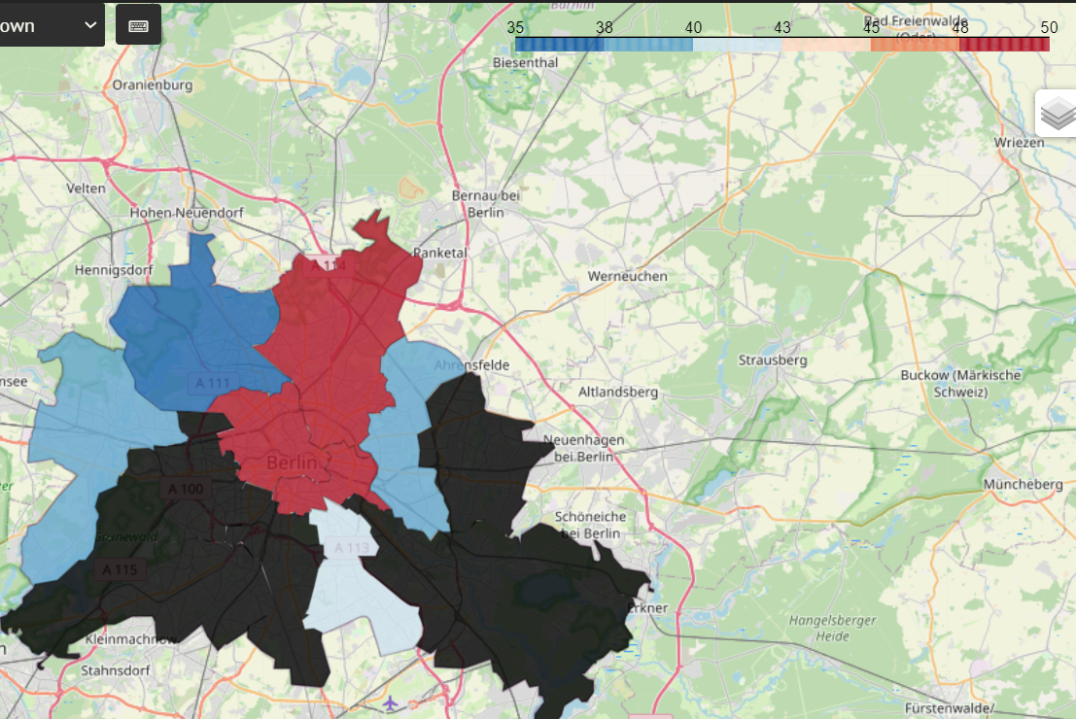
NEIGHBOURHOOD
Mean Price
Median Price

Slide 8
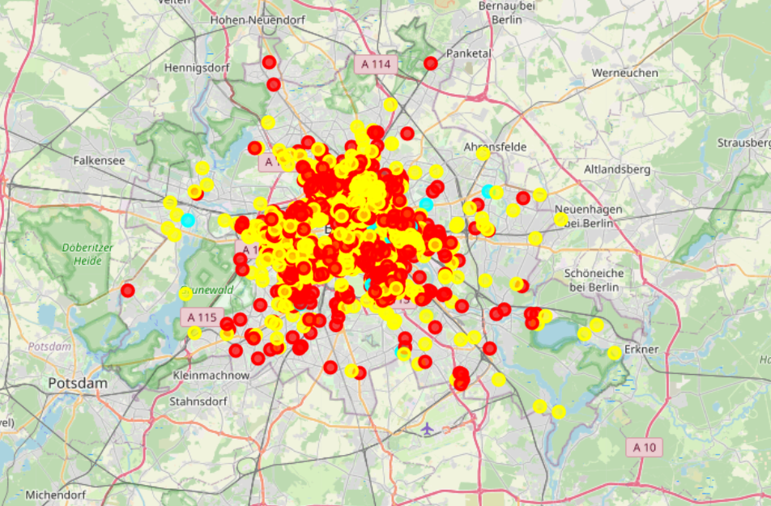
GEOSPATIAL ANALYSIS
ROOM TYPE
ENTIRE APT- YELLOW
PRIVATE ROOM- RED
SHARED ROOM- CYAN

Slide 9
Algorithms:
Algorithm used: XGBoost Regressor
Reason for use:
We are trying to predict price which is a continuous variable.
It is a decision-tree-based ensemble ML algorithm that uses a gradient boosting framework.
This prediction problems involve unstructured data.
Advantage:
If one can actually do it accurately, fast and secretly for as long as the market assumptions stay stationary, one will get appropriate price and he/she can enjoy the stay.
Disadvantage:
Practically impossible to do, if new travel and stay apps with a better pricing (discounts)come into market. In this Highly competitive field any relevant insights will be made in private space. It will work only till other competitors are with higher price and no more modifications are done to the data.

Slide 10
Solution
Solution architecture
Identify Data required
Upload csv file
Pre-process data
Create training and testing set
Select appropriate algorithms
Train and build the model
no
yes
Evaluate with test data
Productionize and calibrate

Slide 11
Solution
How to Increase Pricing.
You can give extra parking space.
Complimentary breakfast.
If a host appears more than once, then to give him a discount
Basic toiletries.
Any follow-up potential capstone project problems
Comparing reviews with other columns and variables using natural language processing to predict future experience of customers.
Using the above mentioned algorithms; we were able to predict the target variable with an accuracy of
(Accuracy Score - XGBRegressor - 67% to 68%).
The factors that decide Airbnb rent in Berlin are:
The property type
Location and size.
Conclusion

Slide 12
Thanks!

